Slide 1

Software Requirement Engineering
Part II: Software Requirements Development
Week # 11

Slide 2
The Use-Case Approach
A use case describes a sequence of interactions between a system and an external actor. An actor is a person, another software system, or a hardware device that interacts with the system to achieve a useful goal (Cockburn 2001).
Another name for actor is user role, because actors are roles that the members of one or more user classes can perform with respect to the system (Constantine and Lockwood 1999).
Use cases shift the perspective of requirements development to discussing what users need to accomplish, in contrast to the traditional elicitation approach of asking users what they want the system to do. The objective of the use-case approach is to describe all tasks that users will need to perform with the system.
The stakeholders ensure that each use case lies within the defined project scope before accepting it into the requirements baseline.

Slide 3
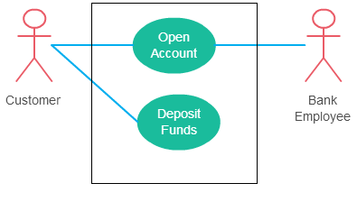
The Use-Case Relationships
There can be 4 relationship types in a use case diagram.
Association between actor and use case
This one is straightforward and present in every use case diagram. Few things to note.
An actor must be associated with at least one use case.
An actor can be associated with multiple use cases.
Multiple actors can be associated with a single use case.

Slide 4
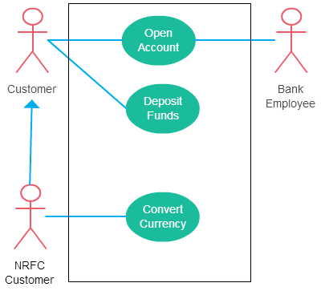
The Use-Case Relationships
Generalization of an actor
Generalization of an actor means that one actor can inherit the role of the other actor. The descendant inherits all the use cases of the ancestor. The descendant has one or more use cases that are specific to that role. Let’s expand the previous use case diagram to show the generalization of an actor.

Slide 5
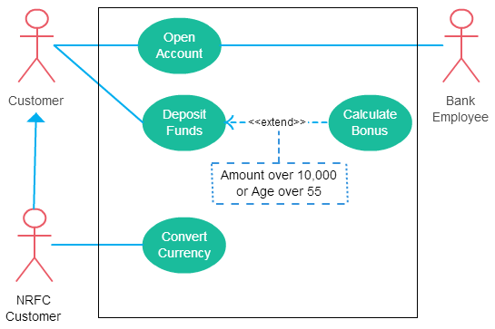
The Use-Case Approach
Extend between two use cases
Many people confuse the extend relationship in use cases. As the name implies it extends the base use case and adds more functionality to the system. Here are a few things to consider when using the <<extend>> relationship.
The extending use case is dependent on the extended (base) use case. In the below diagram the “Calculate Bonus” use case doesn’t make much sense without the “Deposit Funds” use case.
The extending use case is usually optional and can be triggered conditionally. In the diagram, you can see that the extending use case is triggered only for deposits over 10,000 or when the age is over 55.
The extended (base) use case must be meaningful on its own. This means it should be independent and must not rely on the behavior of the extending use case.

Slide 6
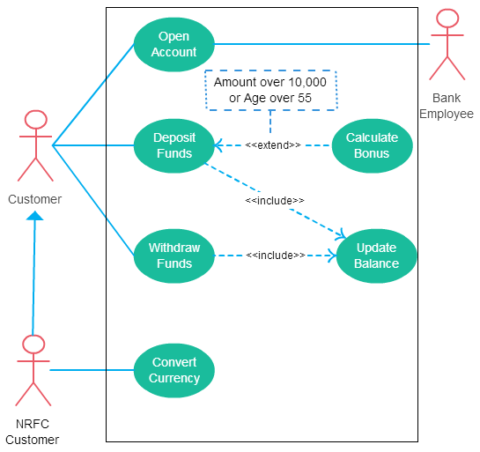
The Use-Case Approach
Include between two use cases
Include relationship show that the behavior of the included use case is part of the including (base) use case. The main reason for this is to reuse common actions across multiple use cases. In some situations, this is done to simplify complex behaviors. Few things to consider when using the <<include>> relationship.
The base use case is incomplete without the included use case.
The included use case is mandatory and not optional.

Slide 7
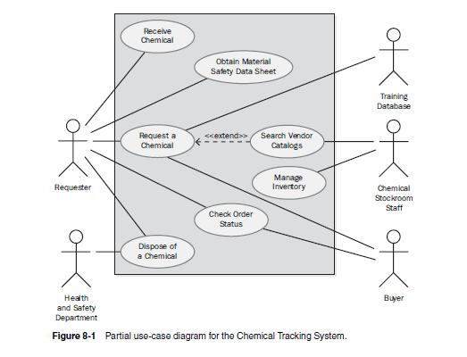
The Use-Case Approach
Use-case diagrams provide a high-level visual representation of the user requirements.

Slide 8
Use Cases and Usage Scenarios
A use case is a discrete, stand-alone activity that an actor can perform to achieve some outcome of value.
A single use case might encompass a number of similar tasks having a common goal. A use case is therefore a collection of related usage scenarios, and a scenario is a specific instance of a use case. When exploring user requirements, you can start with abstract use cases and develop concrete usage scenarios, or you can generalize from a specific scenario to the broader use case.
The essential elements of a use-case description are the following:
A unique identifier
A name that succinctly states the user task in the form of “verb + object,” such as “Place an Order”
A short textual description written in natural language
A list of preconditions that must be satisfied before the use case can begin
Post conditions that describe the state of the system after the use case is successfully completed
A numbered list of steps that shows the sequence of dialog steps or interactions between the actor and the system that leads from the preconditions to the post conditions

Slide 9
Use Cases and Usage Scenarios
One scenario is identified as the normal course of events for the use case; it is also called the main course, basic course, normal flow, primary scenario, main success scenario, and happy path. The normal course for the “Request a Chemical” use case is to request a chemical that’s available in the chemical stockroom.
Other valid scenarios within the use case are described as alternative courses or secondary scenarios (Schneider and Winters 1998). Alternative courses also result in successful task completion and satisfy the use case’s post conditions. However, they represent variations in the specifics of the task or in the dialog sequence used to accomplish the task. The normal course can branch off into an alternative course at some decision point in the dialog sequence and rejoin the normal course later.

Slide 10
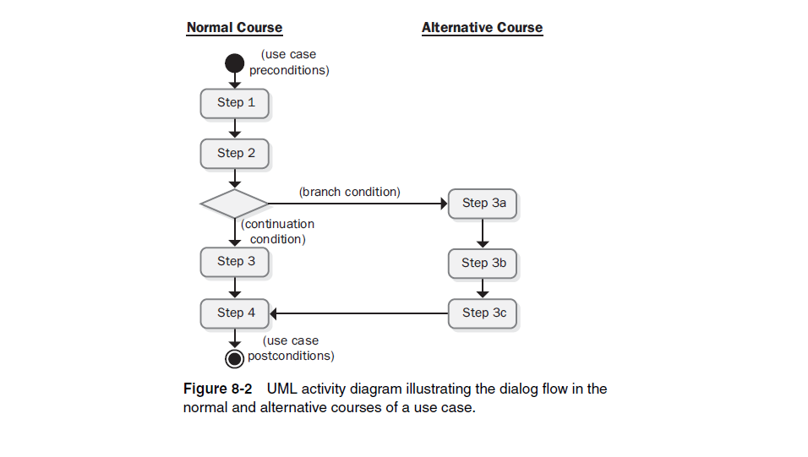

Slide 11
Use Cases and Usage Scenarios
Sometimes several use cases share a common set of steps. To avoid duplicating these steps in each such use case, define a separate use case that contains the shared functionality and indicate that the other use cases include that sub use case.
Conditions that prevent a task from succeeding are called exceptions. One exception for the “Request a Chemical” use case is “Chemical is not commercially available.” If you don’t specify exception handling during elicitation, there are two possible outcomes:
1. The developers will make their best guesses at how to deal with the exceptions.
2. The system will fail when a user hits the error condition because no one thought about it.
Exceptions are sometimes regarded as a type of alternative course (Cockburn 2001), but it’s useful to separate them. You won’t necessarily implement every alternative course that you identify for a use case, and you might defer some to later releases. However, you must implement the exceptions that can prevent the scenarios that you do implement from succeeding.
Notes:
As an example, consider an accounting software package. Two use cases
are “Pay Bill” and “Reconcile Credit Card,” both of which involve the user writing
a check to make the payment. You can create a separate use case called
“Write Check” that contains the common steps involved in writing the check.
The two transaction use cases both include the “Write Check” use case, as
shown in Figure 8-3.
Anyone who has done computer programming knows that exceptions often generate the bulk of the coding effort. Many of the defects in a finished product reside in exception handlers (or missing exception handlers!). Specifying exception conditions during requirements elicitation is a way to build robust software products.

Slide 12
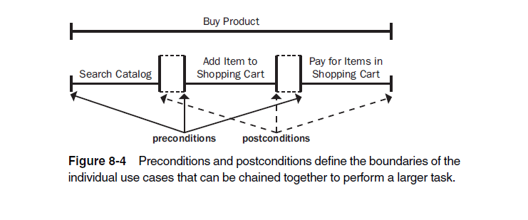
Use Cases and Usage Scenarios
In many systems, the user can chain together a sequence of use cases into a “macro” use case that describes a larger task.
Some use cases for a commercial Web site might be “Search Catalog,” “Add Item to Shopping Cart,” and “Pay for Items in Shopping Cart.” If you can perform each of these activities independently, they are individual use cases. You might also be able to perform all three tasks in a row as a single large use case called “Buy Product,” as shown in Figure.
To make this work, each use case must leave the system in a state that enables the user to commence the next use case immediately. That is, the post conditions of one use case must satisfy the preconditions of the next one in the sequence.
Notes:
Similarly, in a transaction-processing application such as an ATM, each use case must leave the system in a state that permits the next transaction to begin. The preconditions and postconditions of each transaction use case must align.

Slide 13
Identifying Use Cases
You can identify use cases in several ways (Ham 1998; Larman 1998):
Identify the actors first, and then identify the business processes in which each participates.
Identify the external events to which the system must respond, and then relate these events to participating actors and specific use cases.
Express business processes in terms of specific scenarios, generalize the scenarios into use cases, and identify the actors involved in each use case.
Derive likely use cases from existing functional requirements. If some requirements don’t trace to any use case, consider whether you really need them.

Slide 14
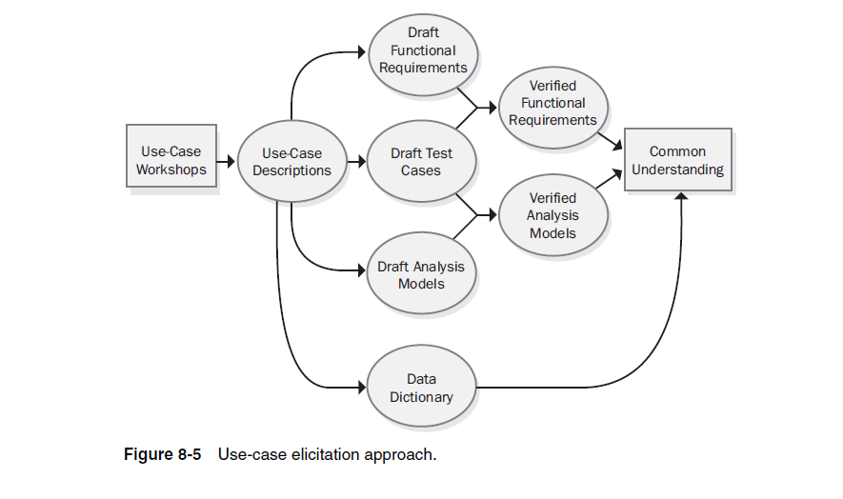
Documenting Use Cases
Notes:
Read description from book

Slide 15
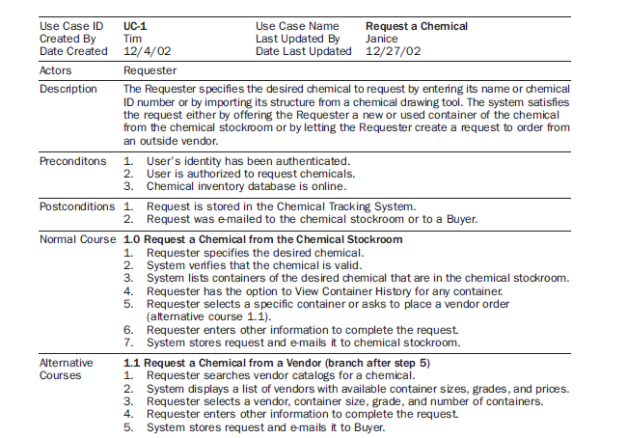
Documenting Use Cases

Slide 16
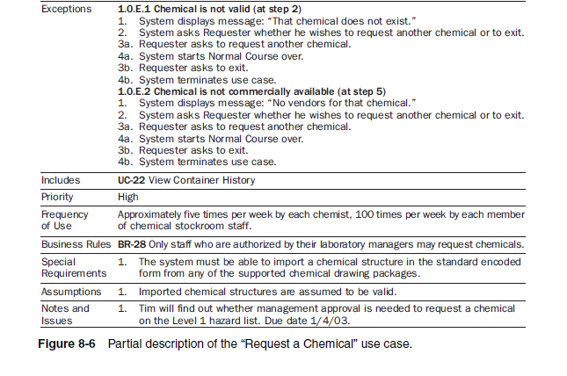
Documenting Use Cases

Slide 17
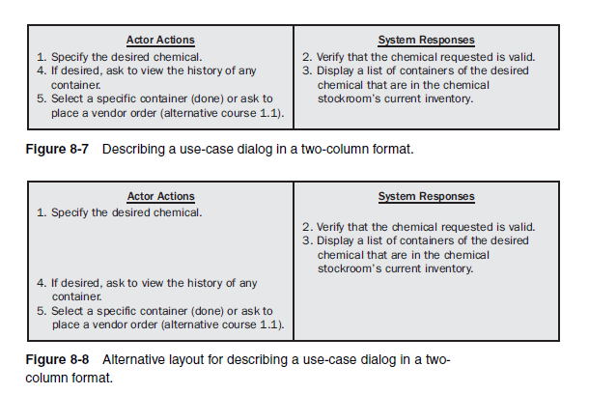
Documenting Use Cases

Slide 18
Documenting Use Cases
You don’t always need a comprehensive use-case description. Alistair Cockburn (2001) describes casual and fully dressed use-case templates. Figure 8-6 illustrates a fully dressed use case.
A casual use case is simply a textual narrative of the user goal and interactions with the system, perhaps just the “Description” section from Figure 8-6. The user stories that serve as requirements in Extreme Programming are essentially casual use cases typically written on index cards (Jeffries, Anderson, and Hendrickson 2001).
Fully dressed use-case descriptions are valuable when
Your user representatives are not closely engaged with the development team throughout the project.
The application is complex and has a high risk associated with system failures.
The use-case descriptions are the lowest level of requirements detail that the developers will receive.
You intend to develop comprehensive test cases based on the user requirements.
Collaborating remote teams need a detailed, shared group memory.

Slide 19
Documenting Use Cases
A day or two after each workshop the analyst gave the use-case descriptions and functional requirements to the workshop participants, who reviewed them prior to the next workshop.
These informal reviews revealed many errors:
previously undiscovered alternative courses, new exceptions, incorrect functional requirements, and missing dialog steps.
Leave at least one day between successive workshops.
The mental relaxation that comes after a day or two away from an intellectually intensive activity allows people to examine their earlier work from a fresh perspective.
One analyst who held workshops every day learned that the participants had difficulty finding errors in the documents they reviewed because the information was too fresh in their minds.
They mentally recited the workshop discussion that had just taken place and didn’t see the errors.

Slide 20
Use Cases and Functional Requirements
Software developers don’t implement business requirements or use cases. They implement functional requirements, specific bits of system behavior that allow users to execute use cases and achieve their goals.
For instance, the user of an ATM doesn’t care about any back-end processing the ATM must perform, such as communicating with the bank’s computer. This detail is invisible to the user, yet the developer needs to know about it. Of course, the use-case descriptions can include this kind of back-end processing detail, but it typically won’t come up in discussions with end users. Developers who are presented with even fully dressed use cases often have many questions.
To reduce this uncertainty, I recommend that requirements analysts explicitly specify the detailed functional requirements necessary to implement each use case (Arlow 1998).

Slide 21
Use Cases and Functional Requirements
Many functional requirements fall right out of the dialog steps between the actor and the system. Some are obvious, such as “The system shall assign a unique sequence number to each request.” There is no point in duplicating those details in an SRS if they are perfectly clear from reading the use case.
Other functional requirements don’t appear in the use-case description. The analyst will derive them from an understanding of the use case and the system’s operating environment. This translation from the user’s view of the requirements to the developer’s view is one of the many ways the requirements analyst adds value to the project.

Slide 22
Use Cases and Functional Requirements
The Chemical Tracking System employed the use cases primarily as a mechanism to reveal the necessary functional requirements. The analysts wrote only casual descriptions of the less complex use cases.
They then derived all the functional requirements that, when implemented, would allow the actor to perform the use case, including alternative courses and exception handlers.
The analysts documented these functional requirements in the SRS, which was organized by product feature.
You can document the functional requirements associated with a use case in several ways. The approach you choose depends on whether you expect your team to perform the design, construction, and testing from the use-case documents, from the SRS, or from a combination of both.
None of these methods is perfect, so select the approach that best fits with how you want to document and manage your project’s software requirements.

Slide 23
Use Cases Only
One possibility is to include the functional requirements right in each use-case description. You’ll still need a separate supplementary specification to contain the nonfunctional requirements and any functional requirements that are not associated with specific use cases.
Several use cases might need the same functional requirement. If five use cases require that the user’s identity be authenticated, you don’t want to write five different blocks of code for that purpose.
Rather than duplicate them, cross-reference functional requirements that appear in multiple use cases. In some instances, the use-case includes relationship discussed earlier in this chapter solves this problem.

Slide 24
Use Cases and SRS
Another option is to write fairly simple use-case descriptions and document the functional requirements derived from each use case in an SRS.
In this approach, you’ll need to establish traceability between the use cases and their associated functional requirements.
The best way to manage the traceability is to store all use cases and functional requirements in a requirements management tool.

Slide 25
SRS Only
A third approach is to organize the SRS by use case or by feature and include both the use cases and the functional requirements in the SRS. This is the approach that the Chemical Tracking System team used.
This scheme doesn’t use separate use-case documents. You’ll need to identify duplicated functional requirements or state every functional requirement only once and refer to that initial statement whenever the requirement reappears in another use case.

Slide 26
Benefits of Use Cases
The power of the use-case approach comes from its task-centric and user-centric perspective. The users will have clearer expectations of what the new system will let them do than if you take a function-centric approach.
Use cases help analysts and developers understand both the user’s business and the application domain.
The use case approach leads to functional requirements that will allow the user to perform certain known tasks. This helps prevent “orphan functionality,” those functions that seem like a good idea during elicitation but which no one uses because they don’t relate directly to user tasks.

Slide 27
Benefits of Use Cases
The use-case approach helps with requirements prioritization. The highest priority functional requirements are those that originated in the top priority use cases. A use case could have high priority for several reasons:
It describes one of the core business processes that the system enables.
Many users will use it frequently.
A favored user class requested it.
It provides a capability that’s required for regulatory compliance.
Other system functions depend on its presence.

Slide 28
Benefits of Use Cases
There are technical benefits, too. The use-case perspective reveals some of the important domain objects and their responsibilities to each other.
Developers using object-oriented design methods can turn use cases into object models such as class and sequence diagrams. (Remember, though, use cases are by no means restricted to object-oriented development projects.)
As the business processes change over time, the tasks that are embodied in specific use cases will change. If you’ve traced functional requirements, designs, code, and tests back to their parent use cases—the voice of the customer—it will be easier to cascade those business-process changes throughout the entire system.

Slide 29
Use-Case Traps to Avoid
Too many use cases
Highly complex use cases
Including user interface design in the use cases
Including data definitions in the use cases
Use cases that users don’t understand
New business processes
Excessive use of includes and extends relationships

Slide 30
Event-Response Tables
Another way to organize and document user requirements is to identify the external events to which the system must respond. An event is some change or activity that takes place in the user’s environment that stimulates a response from the software system (McMenamin and Palmer 1984; Wiley 2000).
An event-response table (also called an event table or an event list) lists all such events and the behavior the system is expected to exhibit in reaction to each event.

Slide 31
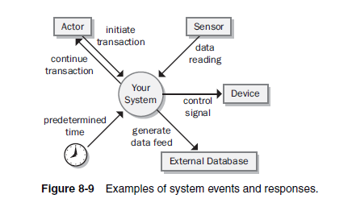
Event-Response Tables
There are several types of system events, as shown in Figure :
Notes:
An action by a human user that stimulates a dialog with the software, as when the user initiates a use case (sometimes called a business event). The event-response sequences correspond to the dialog steps in a use case. Unlike use cases, the event-response table does not describe the user’s goal in using the system or state why this event response sequence provides value to the user.
A control signal, data reading, or interrupt received from an external hardware device, such as when a switch closes, a voltage changes, or the user moves the mouse.
A time-triggered event, as when the computer’s clock reaches a specified time (say, to launch an automatic data export operation at midnight) or when a preset duration has passed since a previous event (as in a system that logs the temperature read by a sensor every 10 seconds).

Slide 32
Event-Response Tables
Event-response tables are particularly appropriate for real-time control systems.
Note that the expected response depends not only on the event but also on the state the system is in at the time the event takes place.
The event-response table records information at the user-requirements level. If the table defines and labels every possible combination of event, state, and response (including exception conditions), the table can also serve as part of the functional requirements for that portion of the system.
However, the analyst must supply additional functional and nonfunctional requirements in the SRS.
Notice that the events listed in Table 8-1 are written at the essential level (describing the essence of the event), not at the implementation level (describing the specifics of the implementation).
Notes:
For instance, events 4 and 5.1 in Table 8-1 result in slightly different behaviors depending on whether the wipers were on at the time the user set the wiper control to the intermittent setting.
A response might simply alter some internal system information (events 4 and 7.1 in the table) or it could result in an externally visible result (most other events).

Slide 33
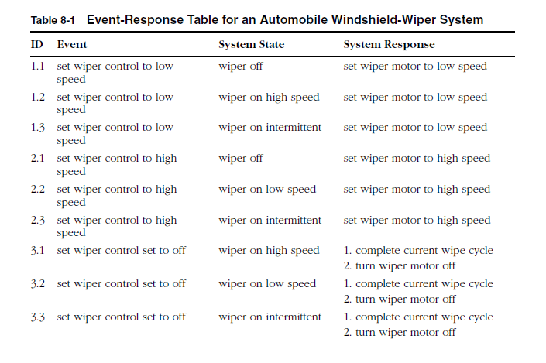
Event-Response Tables

Slide 34
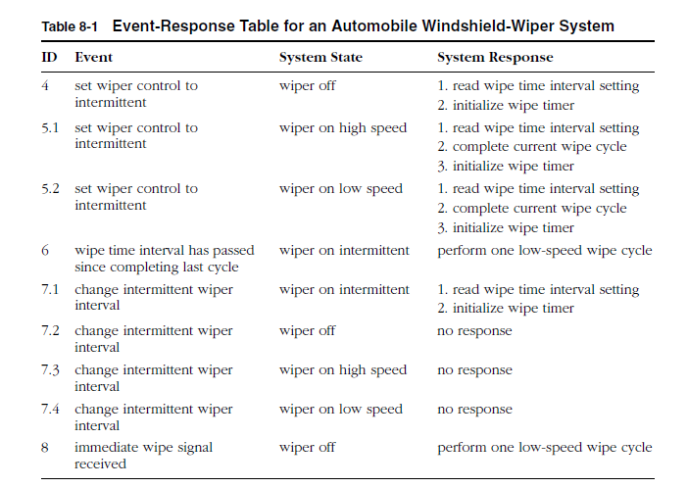
Event-Response Tables

